Slide 1
Analysis of Fluor Financials
FIN 517 Group Project
Notes:
Daniel

Slide 2
FIN 517 Group Project Members
Boris Gutman
Brent Wallace
Christina Wei
Daniel Eguina
Martin Zapata
Notes:
Daniel

Slide 3
Fluor Corporation, Inc. – Overview
Industry leader with global experience and proven expertise in:
Energy and Chemicals
Industrial and Infrastructure
Government
Global Services
Power
43,000 global employees
Academic degrees in more than 100 engineering and 60 scientific fields.
Notes:
Daniel

Slide 4
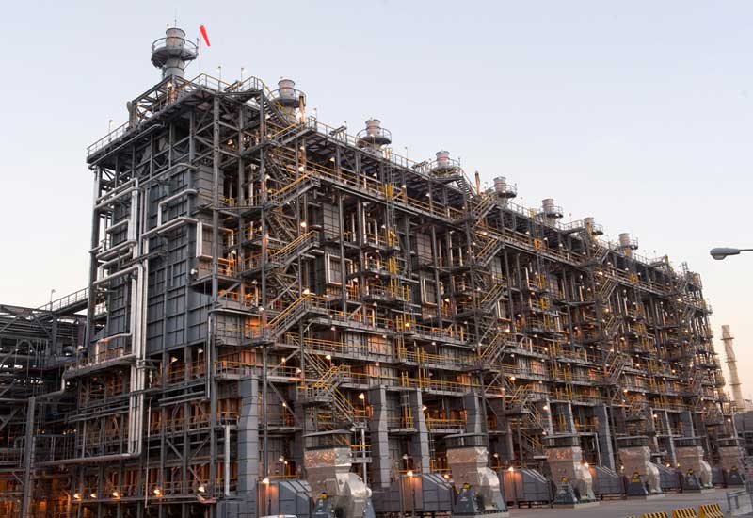
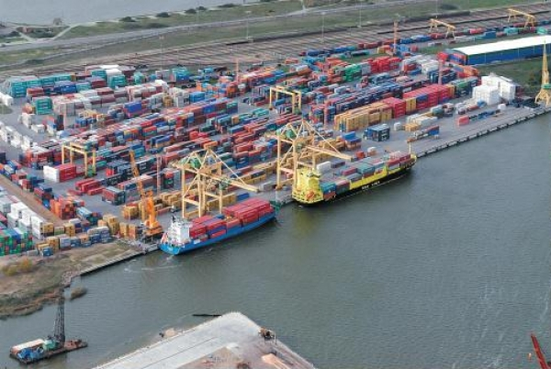
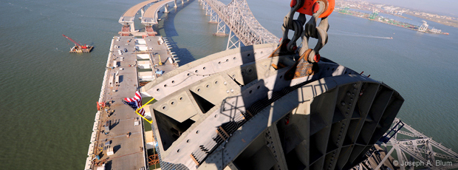
Fluor Corporation, Inc. – Overview
Kuwait Olefins II Project
LNG Platform Support in Lithuania
SF-Oakland Bay Bridge Project (in progress)
Notes:
Daniel

Slide 5
Fluor Corporation, Inc. – Overview
Financial Status as of 12/31/2011
Revenues - $23,381,399,000
Net Income - $593,728,000
Cash/Equivalents - $2,161,411,000
Total Assets - $8,270,276,000 in Total Assets
Long-term Debt - $513,500,000
Was only $17,759,000 in 2010
Total Shareholder Equity - $3,395,525,000
Notes:
Daniel

Slide 6
Financial Ratios – The Highlights
Economic downslide starting in 2008-2010 affecting the market
Slight recovery in 2011
The selected ratios for analysis are conservative in nature to address the concerns of risk adverse investors
Increase of $500 million in long term debt in 2011
Notes:
Martin

Slide 7
Peer Group Analysis Methodology
Reviewed Financial Statements for the past 5 years
Compared Fluor financial data with:
SAIC, Inc (SAI)
Jacobs Engineering Company (JEC)
Additional peer included Haliburton (HAL), but it is not included in the graphs in this presentation
Notes:
Martin

Slide 8
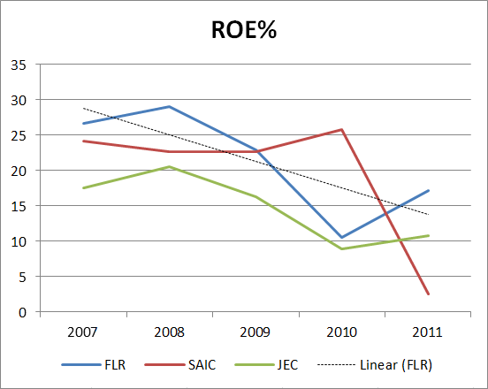
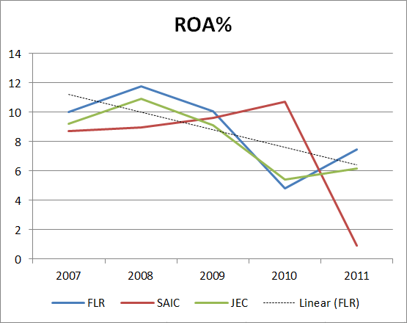
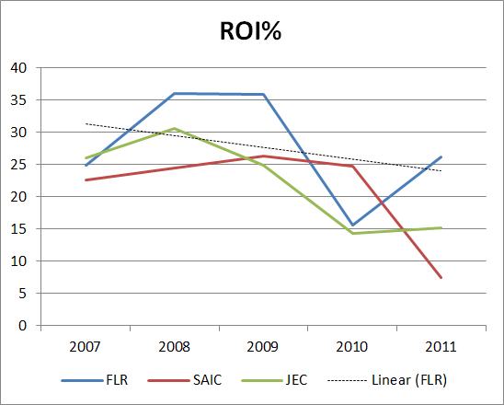
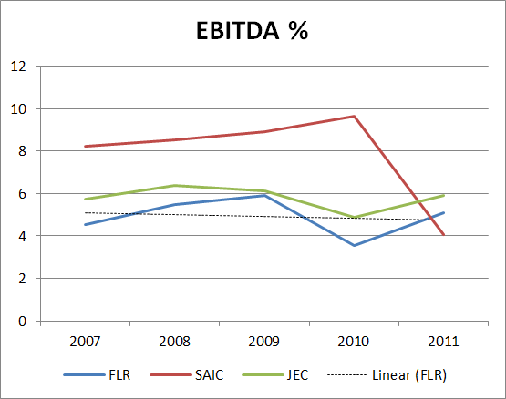
RETURN Analysis Chart with Trendline
Notes:
Martin

Slide 9
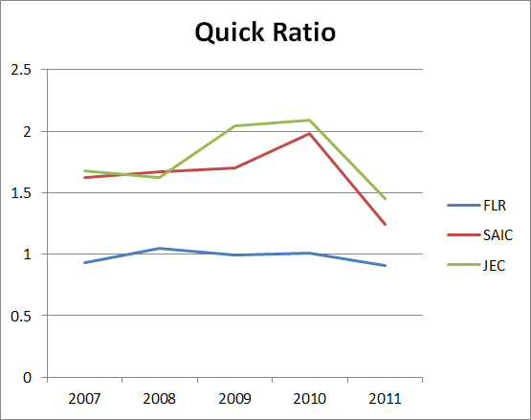
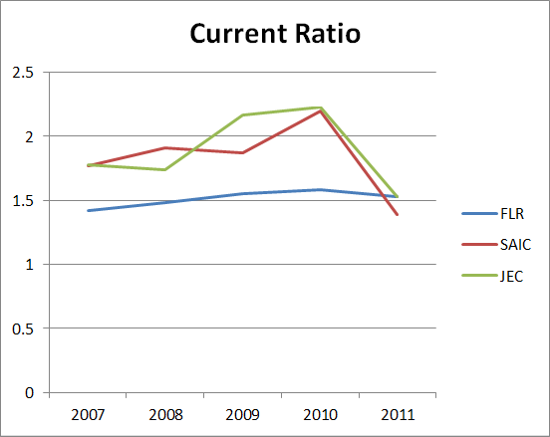
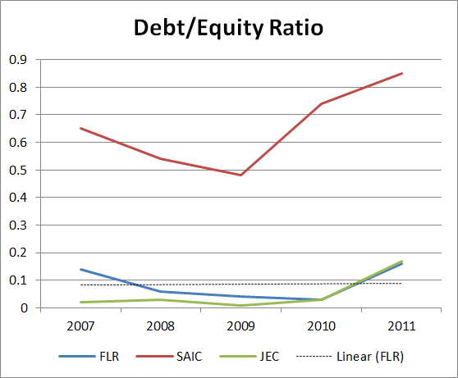
RATIO Analysis Charts with Trendline
Notes:
Christina

Slide 10
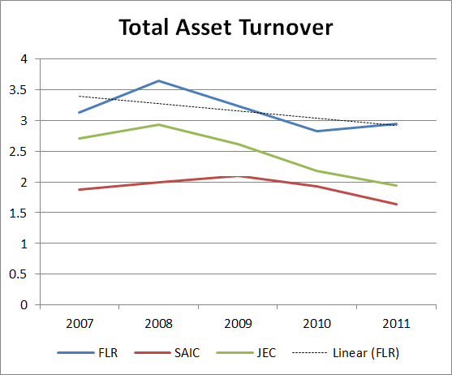
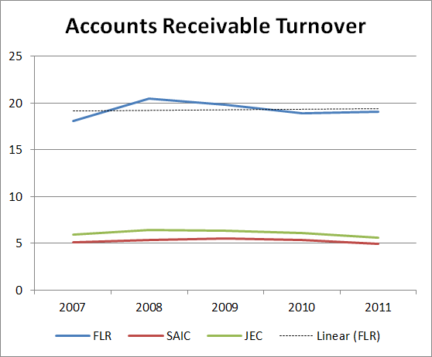
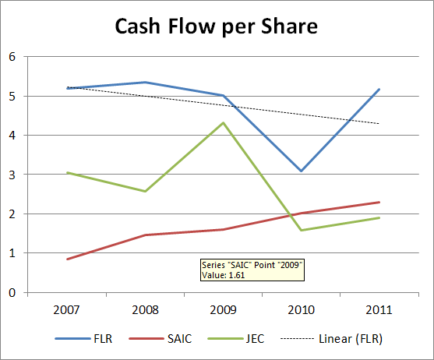
TURNOVER Analysis Charts with Trendlines
Notes:
Christina

Slide 11
Risk Profile Analysis
Risk of Equity
Utilize CAPM
Fluor and S&P 500 Five Year Return Rates
Run Regression Analysis
βeta=1.37 (Standard for Industry)
R²=0.41
41% Market Specific Risk 59% Firm-Specific Risk
Notes:
Boris

Slide 12
Risk Profile Analysis
Equity Cost of Capital
Utilize CAPM
10-Year U.S. Treasury Rate = 1.61%
βeta=1.37
Total Market Return Rate = 2.38%
Equity Cost of Capital = 2.66%
Notes:
Boris

Slide 13
Risk Profile Analysis
A
Equity Cost of Debt
Notes:
Boris; Morning Star Credit Rating

Slide 14
Risk Profile Analysis
Equity Cost of Debt
Fluor Bond Rating of A Beta = 0.05
R_{f} = 1.61% R_{m} = 2.38%
Cost of Debt = R_{f} + Beta(R_{m})
Cost of Debt = 1.73%
Notes:
Boris

Slide 15
Stock Price and Dividends– The Highlights
Using Dividend Discount Model
$13.23 given negative growth of 9.44%
Drop occurred in 2007-2008
Has since then stabilized
If assuming dividend discount model in perpetuity
$60.15
Using Discounted Cash Flow Valuation
$376.69 assuming a stable growth rate of 1.60% and WACC of 2.54%
Notes:
Brent

Slide 16
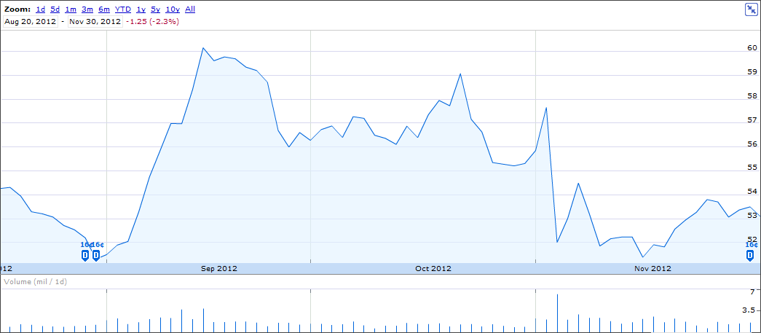
Stock Price Analysis – Fall Semester 2012
High around $60, Low around $51
Notes:
Brent

Slide 17
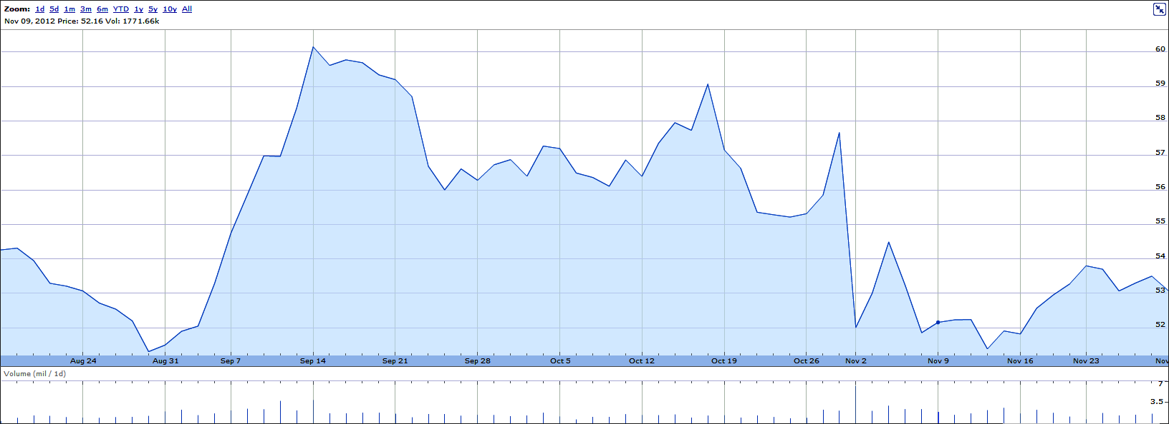
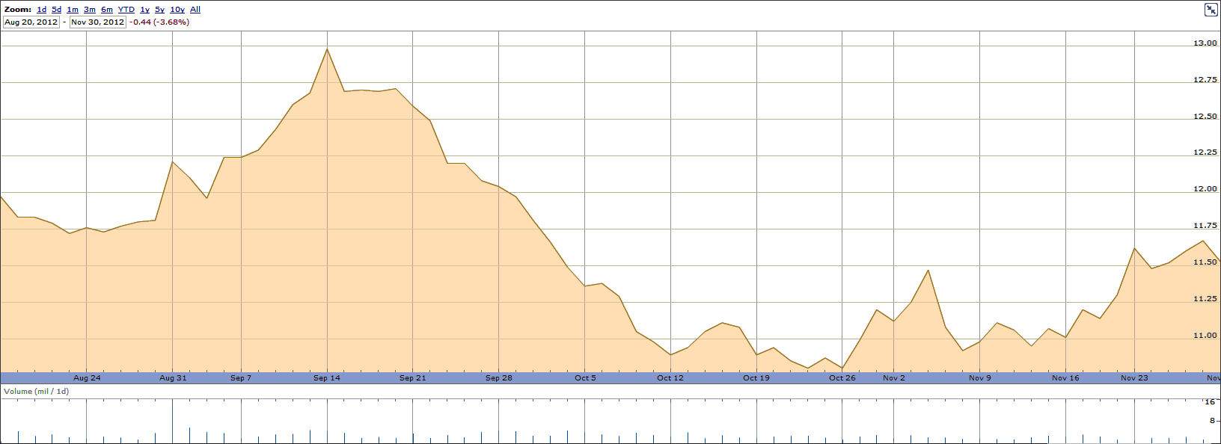
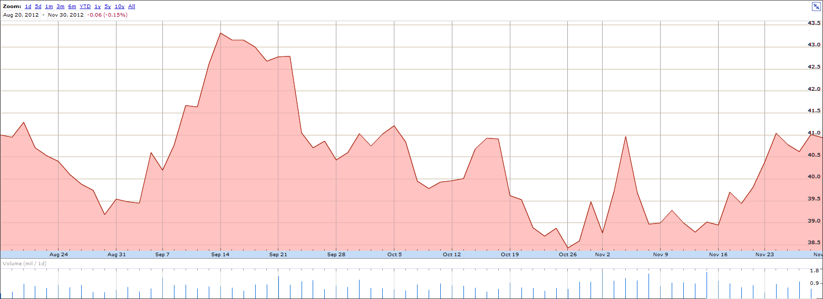
Stock Price Comparison – Fall Semester 2012
FLR
SAI
JEC
Notes:
Brent

Slide 18
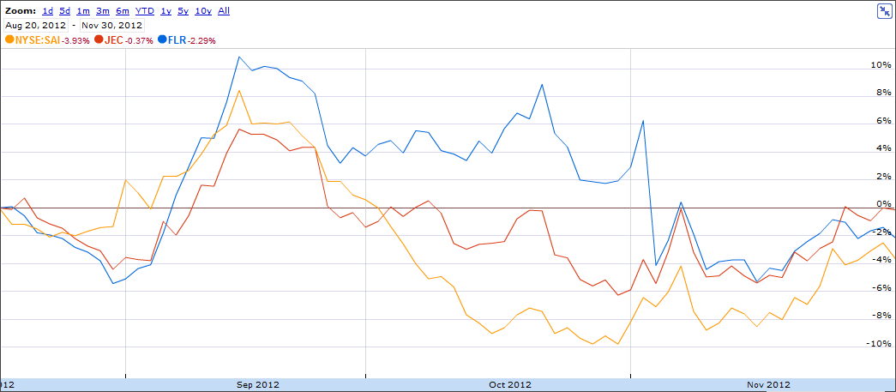
Stock Price Analysis – Fall Semester 2012
Comparison with JEC and SAI
Notes:
Brent

Slide 19
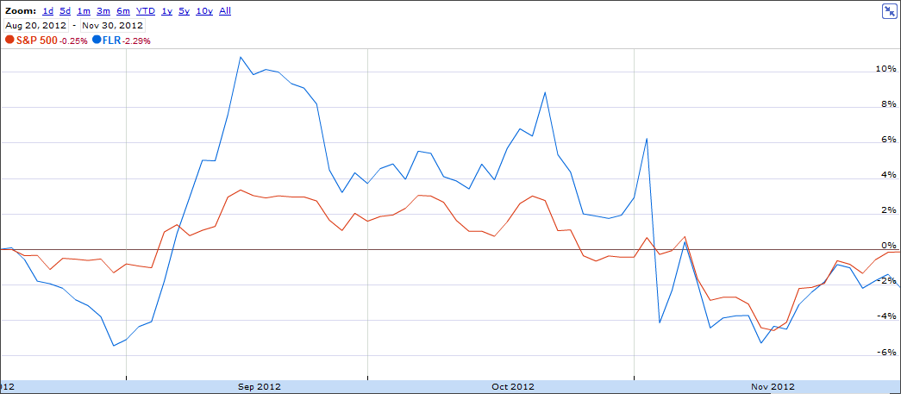
Stock Price Analysis – Fall Semester 2012
Comparison with S&P 500
Notes:
Brent

Slide 20
Investment Recommendations for Fluor
Short-term investment prospects
Slow growth for next 5 years
“Fiscal Cliff” uncertainty in taxes and dollars available for government projects
Not ideal for short-term investments
Long-term investment prospects
Strong financial position, positive ratios
Steady dividend yields
59% risk is diversifiable
Market Cap should increase as economy recovers
Notes:
All

Slide 21
Thank You
Questions?
Additional construction industry risk articles available upon request

